Slide 1
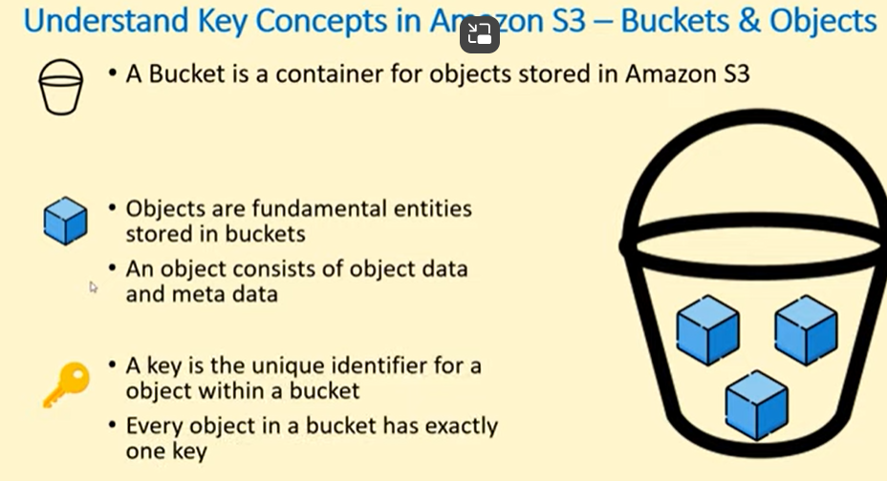
S3 Buckets

Slide 2
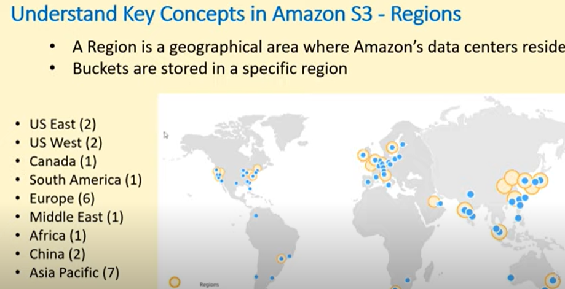

Slide 3
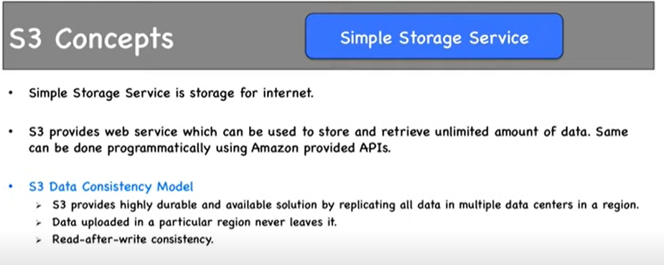

Slide 4
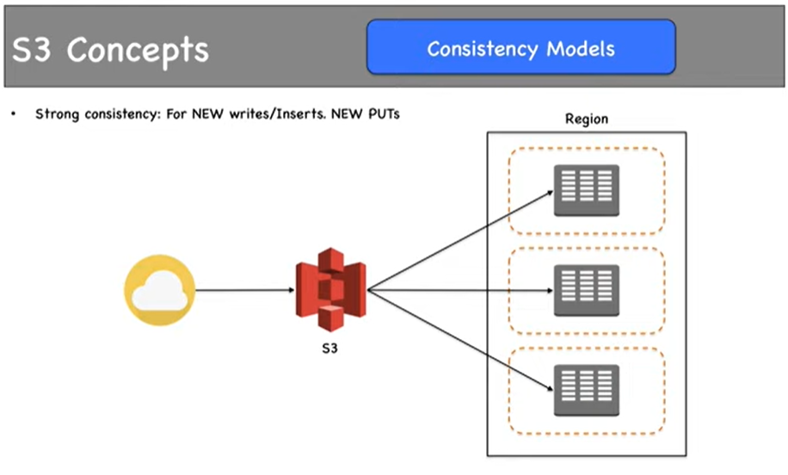

Slide 5
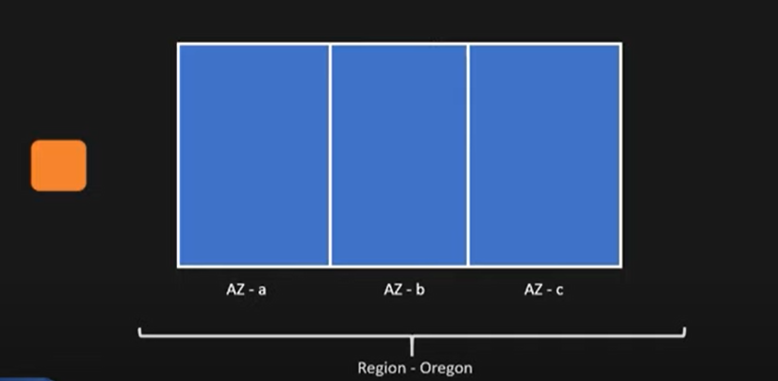
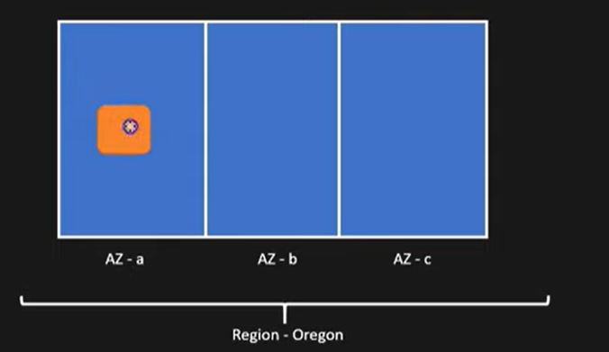
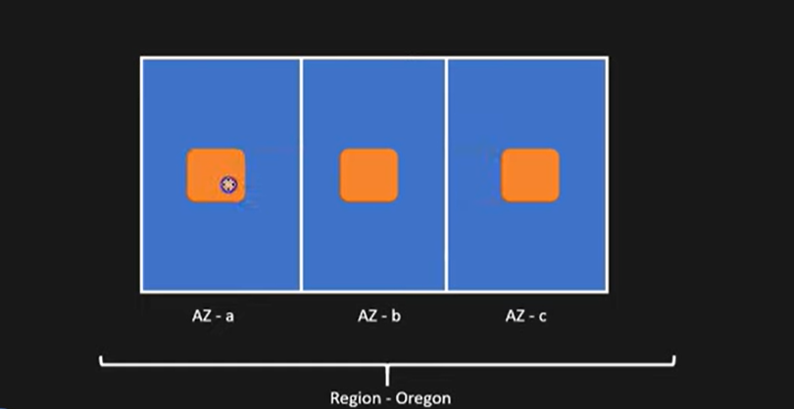

Slide 6
Whenever a new object is added in bucket it will create multiple same copies within other Availability Zone
Now based on size of the file it would take some time from point in time the file was created in one AZ it would take some time to create copied in another AZ depending on size of file
Now two scenario may happen 1) You may update the object or delete the object
Suppose if we upload new image with same file like Overwrite happens slide no 8 (green is new object) it will take some time to get replicated in other AZ green to become all green
Same way if we want to delete one object it will not delete copies from all AZ in one short it take some time to get deleted from all the AZ
So once we understand the updation or deletion of file will not happen in One go in all the AZ it will definately take some time for object to replicate now to maintaine this consitancy we have Two types of Consistency

Slide 7
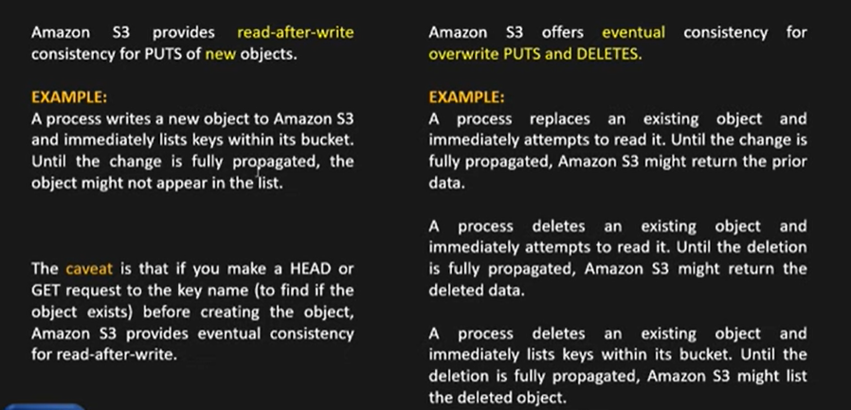

Slide 8
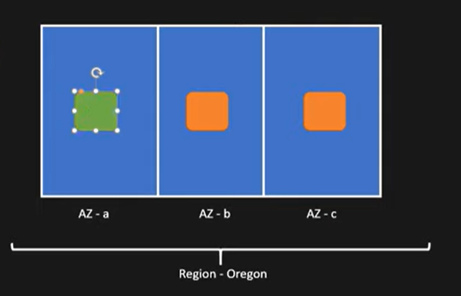
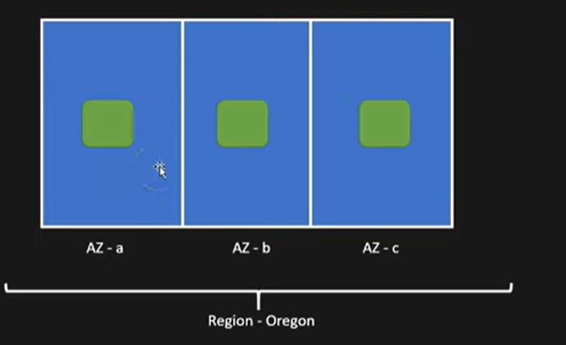

Slide 9
So now by the time request is issued to the time copies are created in all the AZ between that time data is not consistant while this time if read is happned in Bucket that time we may get different data like sometimes we may get Green and sometimes we may get Orange
But S3 will ensure data is replicated to all AZ which is eventually replicated hence the name eventually which will take some time to make same copy
In read after Write : As soon the new data is coming inside bucket means write happens immediately it is made avaialble to read and does not wait for replicating to other AZ
In other words as soon as File is available in One AZ it is ready to give output from that AZ
As read After Write model does not wait to give result till file is created in other AZ thid model is comparatively faster then Eventual Model , Meanwwhile it creates multiple copies behind but gives result from AZ where it is created

Slide 10
In Example of Read After Write . Though you can read file once it is availble in one AZ but we cannot get object when you do list (List aws s3 object name) because Key will be available / applied to bucket only when data / file / object is availble across all AZ
In Eventual type example- By the time objects are created in all AZ it and if you do read it may give older data hence it may give stale read means older data
Same as above untill and unless process deletes existing object from all from AZ if any read happnes to delete object then it may return the deleted object
While all the object is getting deleted if you list iut may list all the deleted items

Slide 11
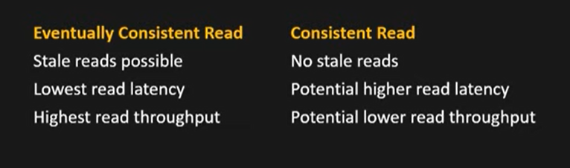

Slide 12
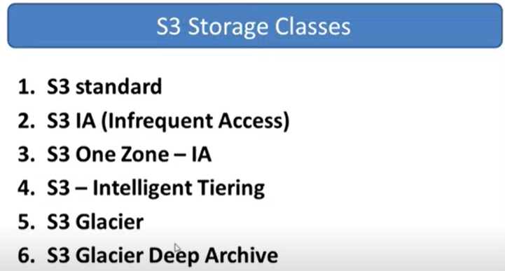

Slide 13
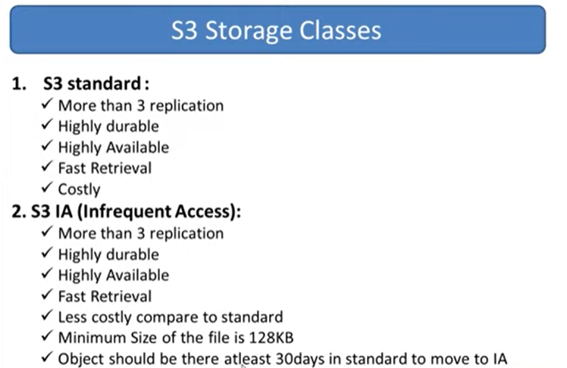

Slide 14
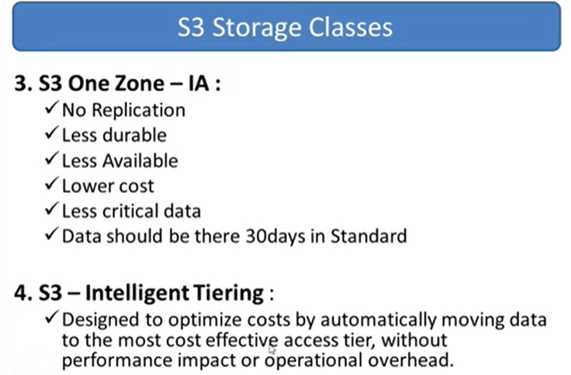

Slide 15
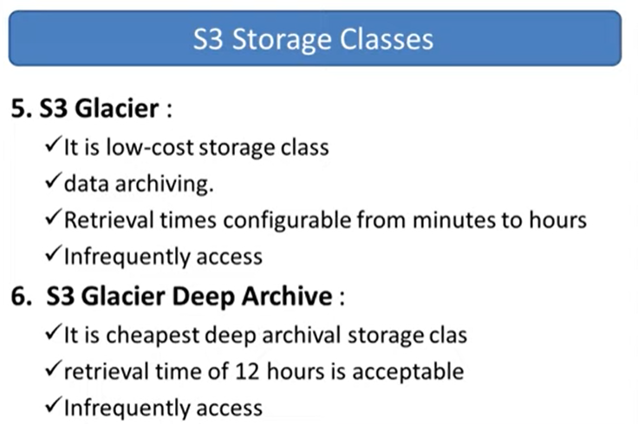

Slide 16
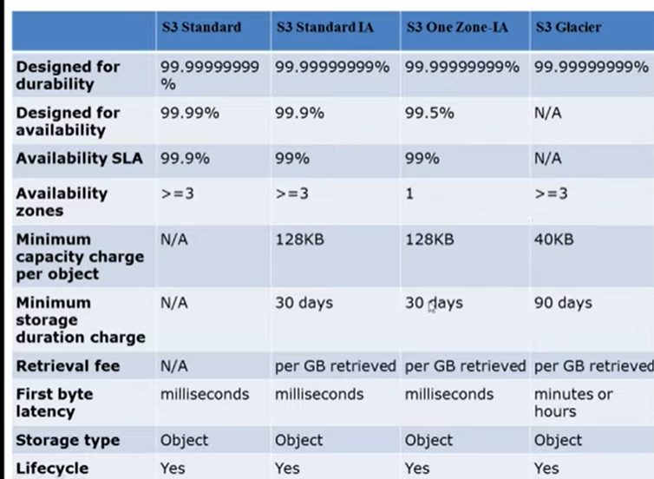

Slide 17
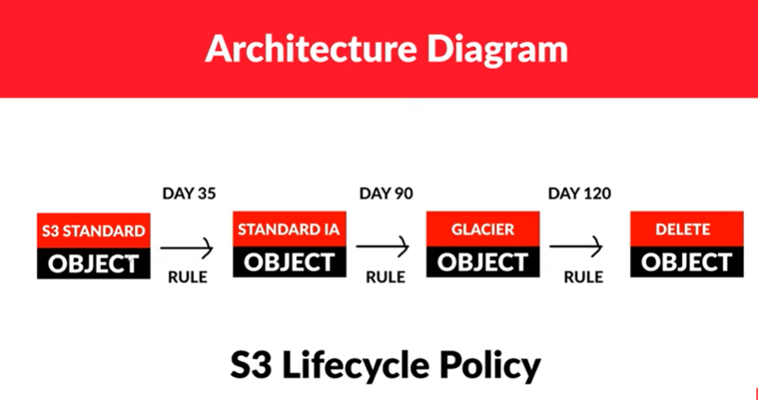

Slide 18
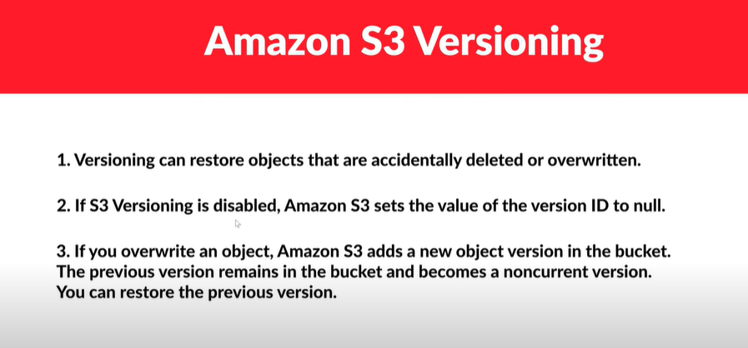

Slide 19
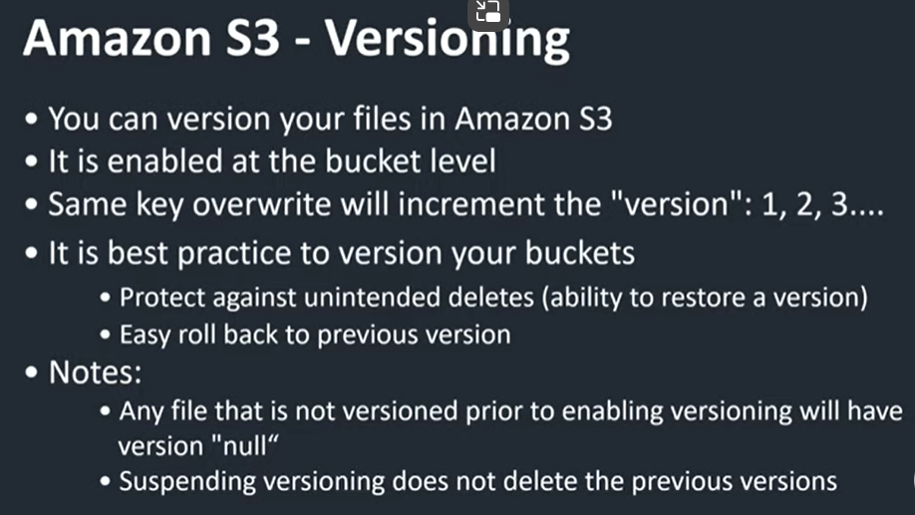

Slide 20

S3 Encryption

Slide 21
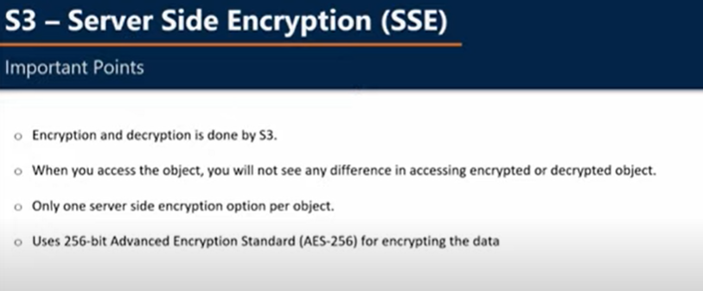

Slide 22
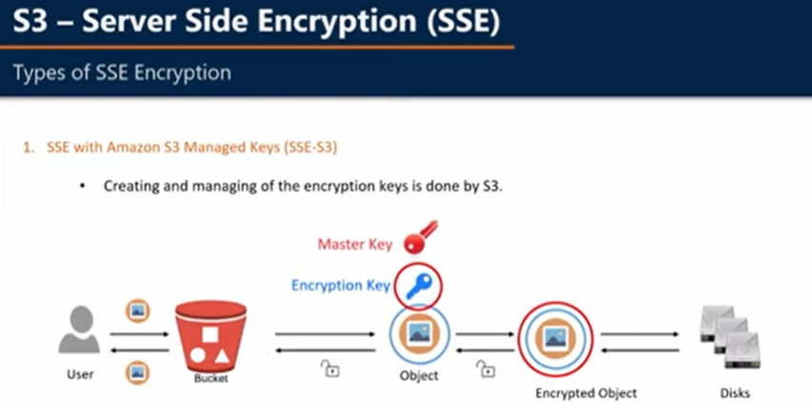

Slide 23
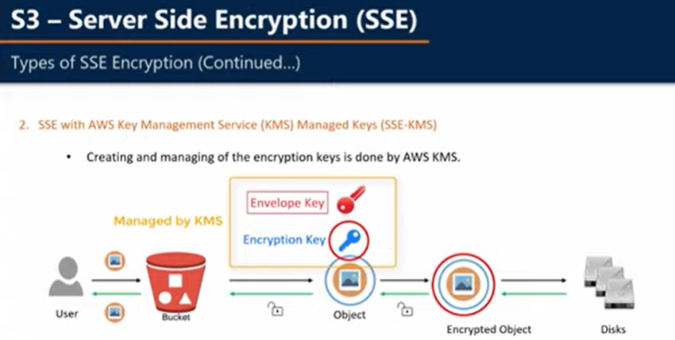

Slide 24
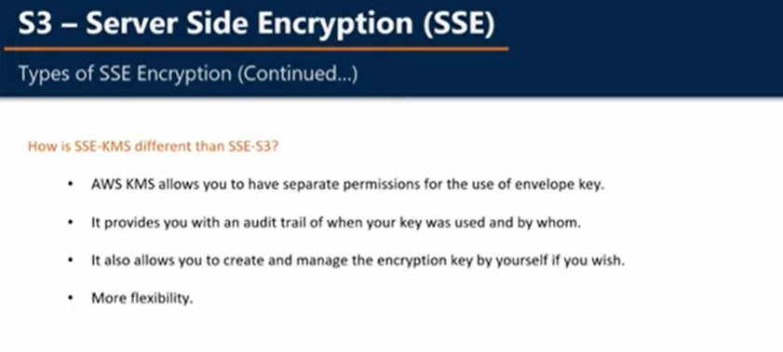

Slide 25
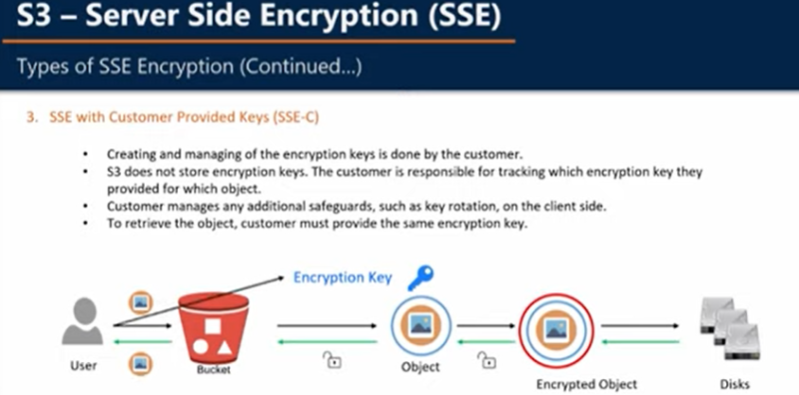

Slide 26


Slide 27
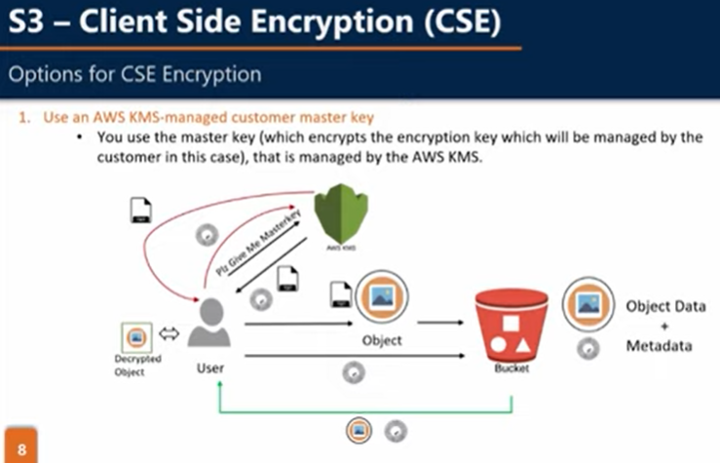

Slide 28
Client request KMS for master key then KMS will return master key in form of two version of keys which is randonly generated Plain text and Cipher block
Client uses Plan text version for encrypting data /object and stores object in S3 bucket it also upload’s Cipher block in S3 bucket as object Metadata as a result the encrypted data with meta data stored in Disk
When user tries to download the data the client downalods the encrypted data and Cipher block (which is Meta data)
Now the cleint sends Cipher block to KMS to retrieve plain key version
using this plain key finally it decrypts the data

Slide 29
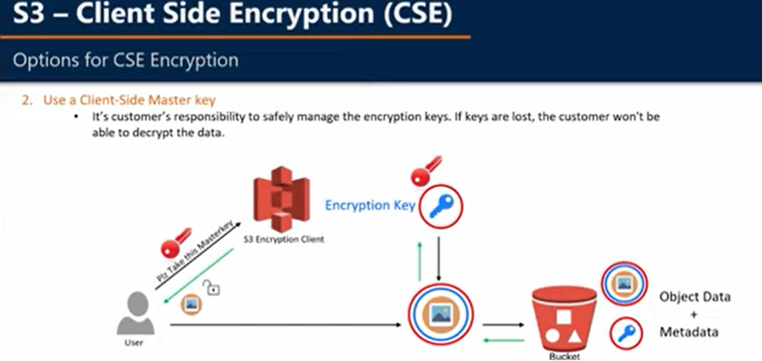

Slide 30
